Slide 1


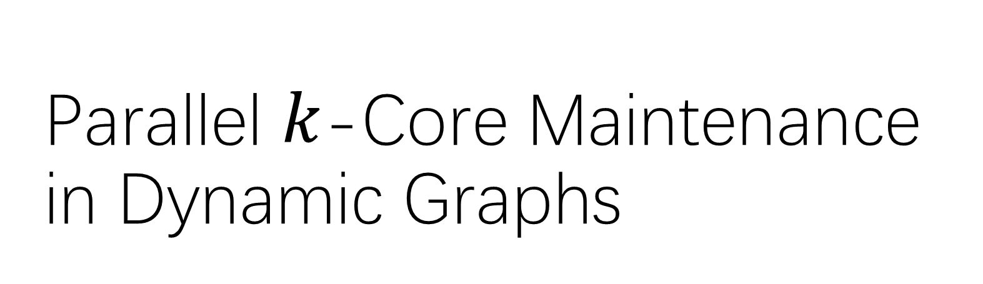
Parallel $k$-Core Maintenance in Dynamic Graphs
Ph.D. Thesis Defense by Bin Guo
Apr. 19, 2023
Committee Members:
Dr. Terry Todd (Chair)
Dr. Emil Sekerinski
Dr. Ryszard Janicki
Dr. Nedialko Nedialkov
Dr. Richard Paige
Dr. Maryam Mehri Dehnavi (University of Toronto)

Slide 2
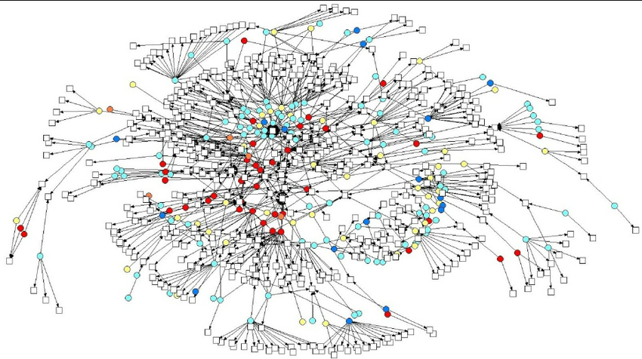


Motivation
Graphs are important data structures used in many applications:
  Social Networks: Facebook, Twitter
  Knowledge Network: DBpedia
  Biological Networks and Road Network
The data graphs are growing larger and larger:
  Facebook has 2.9 billion active users
  Dbpedia has 6.6 million entities and 13 billion pieces of information
Visualizations of Social Networks show the employee interactions [1]
Notes:
Do you know some large graphs?

Slide 3


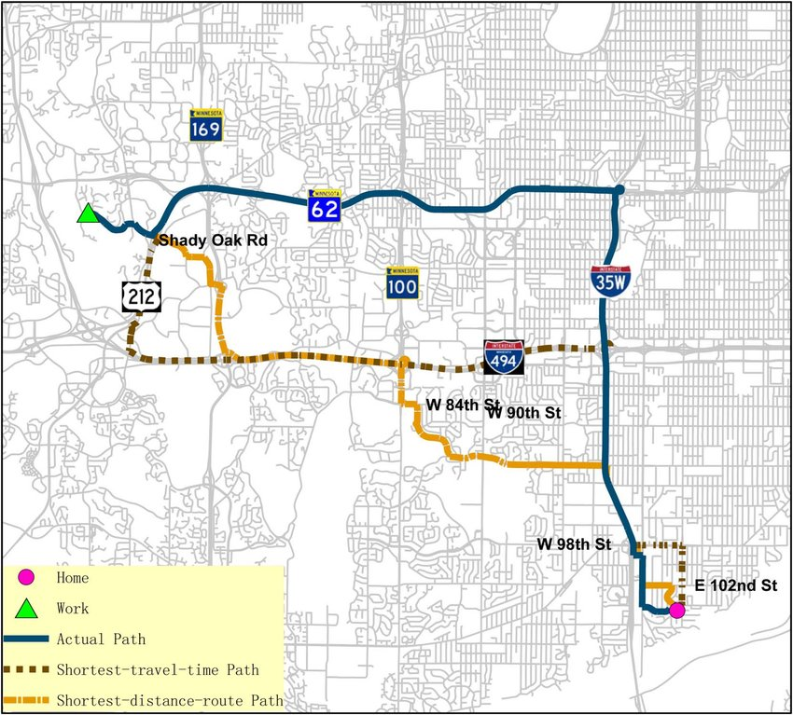
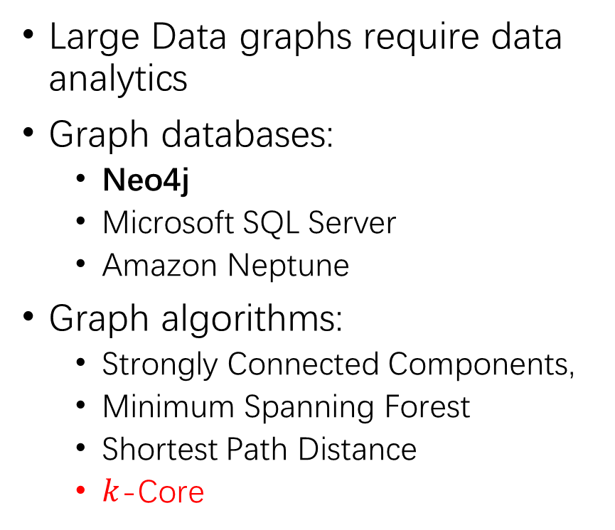
Graph Analytics
Large Data graphs require data analytics
Graph databases:
  Neo4j
  Microsoft SQL Server
  Amazon Neptune
Graph algorithms:
  Strongly Connected Components,
  Minimum Spanning Forest
  Shortest Path Distance
  $k$-Core

Slide 4
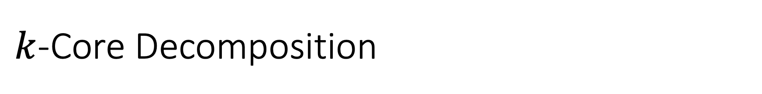
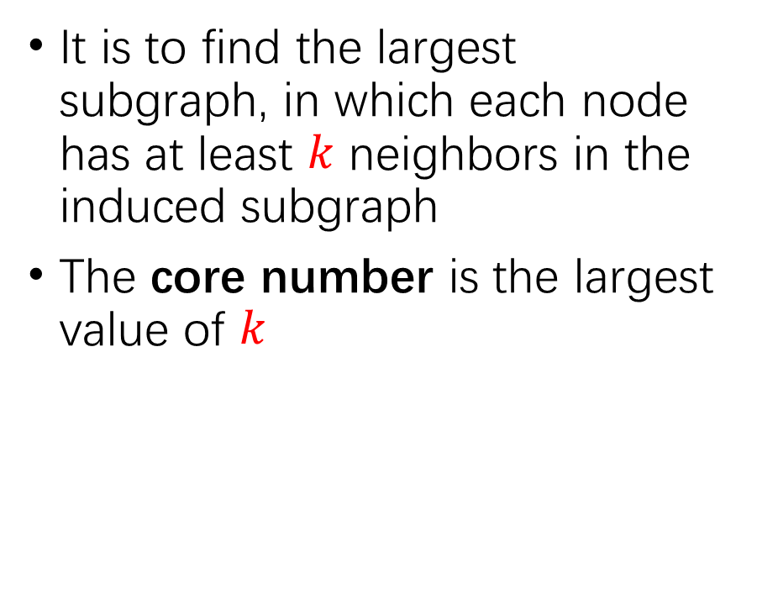
$k$-Core Decomposition
1-core
2-core
It is to find the largest subgraph, in which each node has at least $k$ neighbors in the induced subgraph
The core number is the largest value of $k$
3-core
core number 1
core number 2
core number 3

Slide 5
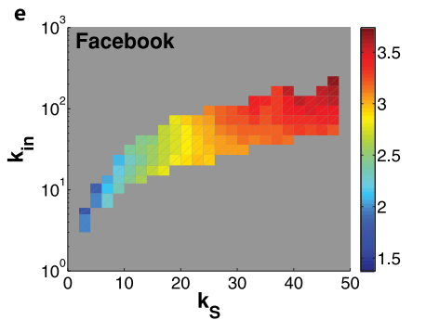
Applications in Social Networks
influence
Social Networks, e.g. Facebook and Twitter
Vertices | individuals
Edges | relations
indegree
The core numbers of vertices can predict the average influence of spreading [1]
For vertices, larger core numbers and larger indgrees indicate higher influence
core number
Use core numbers to predicts the influence of spreading in social networks [1]
[1] Kong, Yi-Xiu, et al. "k-core: Theories and applications." Physics Reports 832 (2019): 1-32.
Notes:
Reference add to here

Slide 6
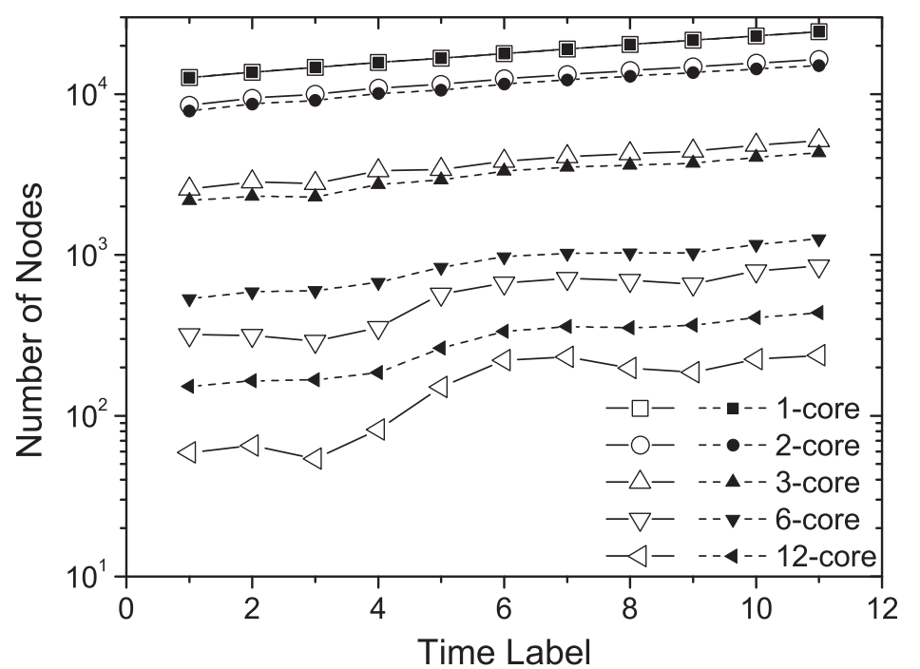
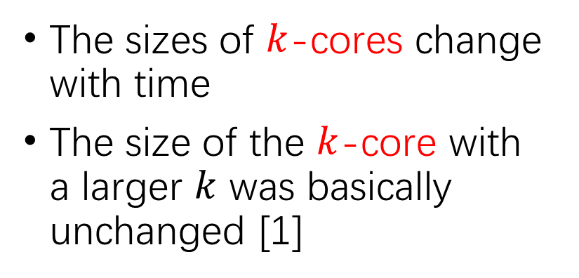
Applications on Analyzing Real Internet networks
Real Internet Networks
Vertices | Websites
Edges | Links
The sizes of $k$-cores change with time
The size of the $k$-core with a larger $k$ was basically unchanged [1]
From Dec. 2001 to Dec. 2006 with six months interval
[1] Kong, Yi-Xiu, et al. "k-core: Theories and applications." Physics Reports 832 (2019): 1-32.

Slide 7
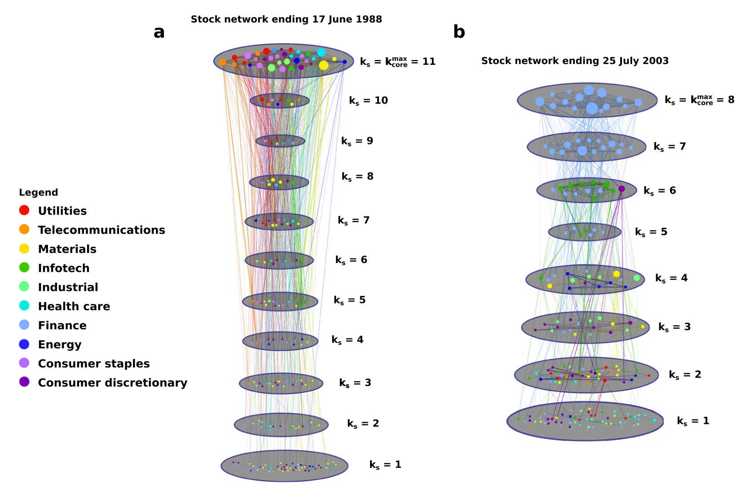
Applications in Economics
max core number
Stock Networks
Vertices | Stocks
Edges | Connections
The max core is dominated by the Finance in 2003 [2]
The Finance has huge effects
[2] Burleson-Lesser, Kate, et al. "K-core robustness in ecological and financial networks.”
Scientific reports 10.1 (2020): 1-14.
Notes:
It means turmoil in the fnancial sector would have negative efects on the stock market and the U.S. economy as a whole.

Slide 8
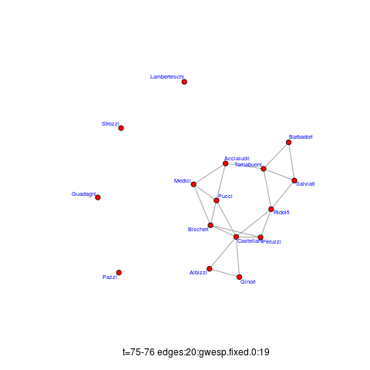
Dynamic Graphs
In practice, all above graphs can be dynamic
Dynamic graphs change with new edges inserted or old edges removed, e.g. temporal graphs
The core numbers have to be updated
A temporal graph with time-evolving edges [3]. Each edge has a time stamp.
[3] Lotito, Quintino Francesco, and Alberto Montresor. "Efficient Algorithms to Mine Maximal Span-Trusses From Temporal Graphs." arXiv preprint arXiv:2009.01928 (2020).

Slide 9
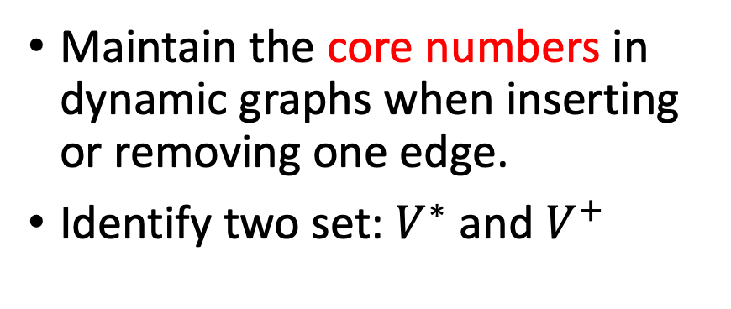

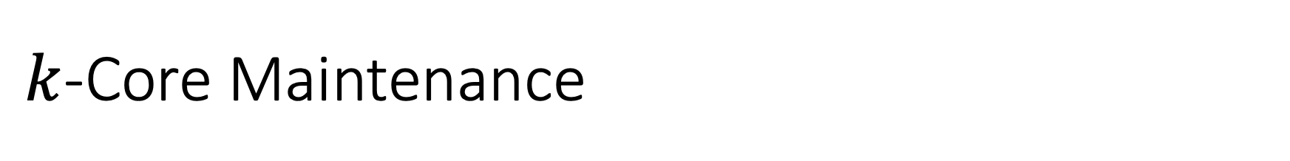
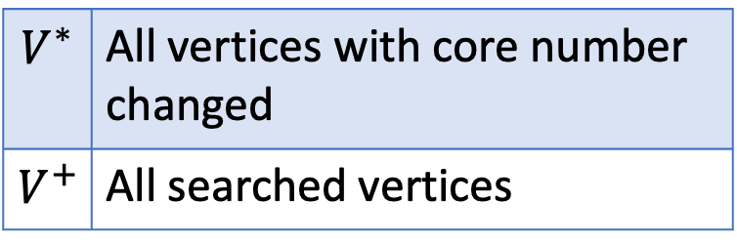


$k$-Core Maintenance
1-core
2-core
Maintain the core numbers in dynamic graphs when inserting or removing one edge.
Identify two set: $V^{∗}$ and $V^{+}$
a
a
3-core
$$V^{∗}$$ | All vertices with core number changed
$$V^{+}$$ | All searched vertices
b
d
c
$$V^{∗}=\left\{a\right\}$$
core number 1
$$V^{+}=\left\{a,b,c,d\right\}$$
core number 2
$$V^{∗}⊆V^{+}$$
core number 3

Slide 10
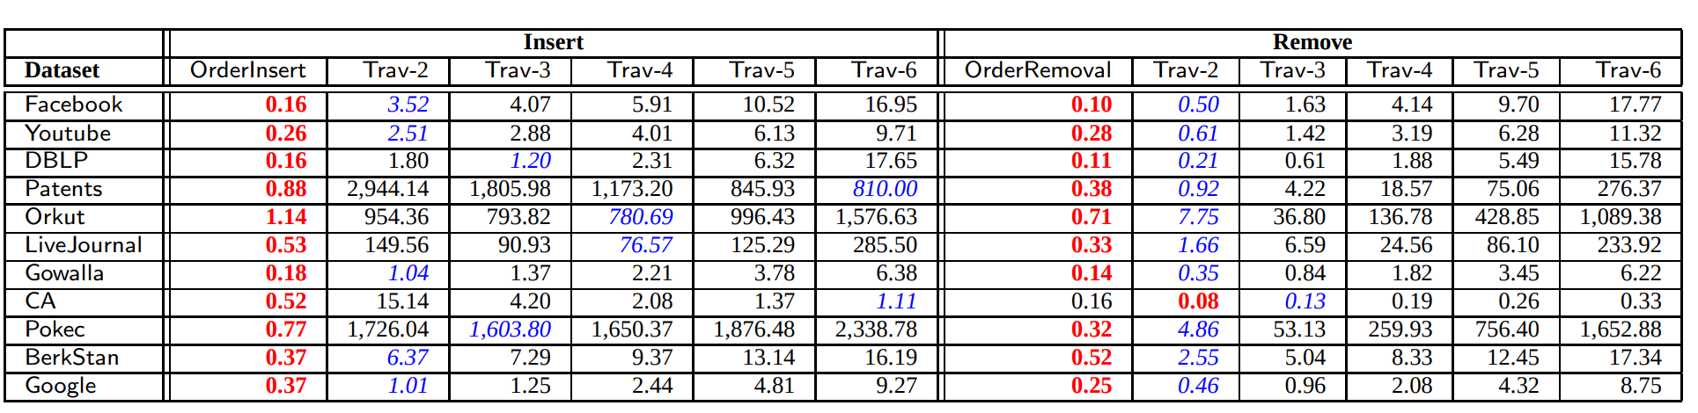

Sequential $k$-Core Maintenance Algorithms
Insert or remove 100,000 edges
(second)
(second)
The Order algorithm is much faster than the Traversal algorithm [4]
The Order algorithm maintains an order for all vertices ($k$-order) to reduce the size of $V^{+}$
[4] Yikai Zhang, Jeffrey Xu Yu, Ying Zhang, and Lu Qin. A fast order-based approach for core maintenance.
ICDE, pages 337–348, 2017.

Slide 11




Order vs Traversal
1-core
2-core
Traversal
$$V^{∗}=\left\{a\right\}$$
a
a
$$V^{+}=\left\{a,b,c,d\right\}$$
3-core
b
d
c
$$V^{∗}=\left\{a\right\}$$
core number 1
Order
$$V^{+}=\left\{a\right\}$$
core number 2
core number 3

Slide 12

Parallel $k$-Core Maintenance
The existing parallel methods [7, 8, 9] are based on Traversal algorithm
We first propose a Simplified-Order algorithm
Then, we propose a Parallel-Order algorithm
[7] Na Wang, Dongxiao Yu, Hai Jin, Chen Qian, Xia Xie, and Qiang-Sheng Hua. Parallel algorithm for core maintenance in dynamic graphs. In 2017 IEEE 37th International Conference on Distributed Computing Systems (ICDCS), pages 2366–2371. IEEE, 2017.
[8] Hai Jin, Na Wang, Dongxiao Yu, Qiang Sheng Hua, Xuanhua Shi, and Xia Xie. Core Maintenance in Dynamic Graphs: A Parallel Approach Based on Matching. IEEE Transactions on Parallel and Distributed Systems, 29(11):2416–2428, nov 2018.
[9] Qiang-Sheng Hua, Yuliang Shi, Dongxiao Yu, Hai Jin, Jiguo Yu, Zhipen Cai, Xiuzhen Cheng, and Hanhua Chen. Faster parallel core maintenance algorithms in dynamic graphs. IEEE Transactions on Parallel and Distributed Systems, 31(6):1287–1300, 2019.

Slide 13

The Studies of $k$-Core Maintenance
Na Wang et al., Superior
Edge Set
ICDCS [7]
Hai Jin et al., Matching Edge Set
ICDCS [8]
Qiang-Sheng Hua et al., Edge Join, TPDS [9]
Bin Guo et al.,
Parallel Order
[10]
Parallel
Ahmet Erdem Saríyüce et al., Streaming VLDB[5]
Ahmet Erdem Sarıyüce et al., Traversal
VLDB [6]
Bin Guo et al., Simplifie-Order
[13]
Yikai Zhang et al., Order
ICDE[4]
Sequential
2013
2016
2017
2018
2019
2022
We are here
Notes:
For five years , no one has make a significant advancement. They ignore that Order is much faster than Traversal. We have made a giant leap. 24 font

Slide 14
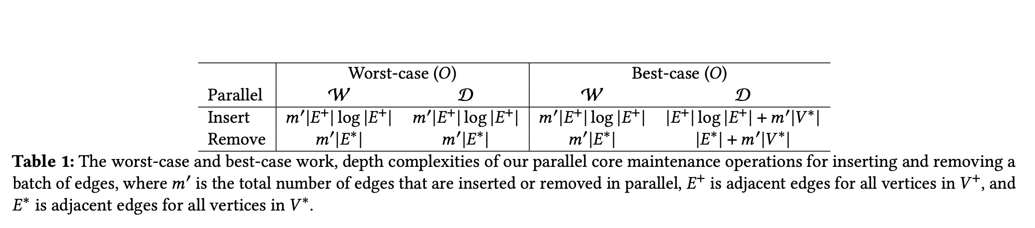
Time Complexity
In the worst case, all workers execute as one blocking chain and reduce to sequential version
The worst case is unlikely to happen over real graphs
The best case has high speedups

Slide 15
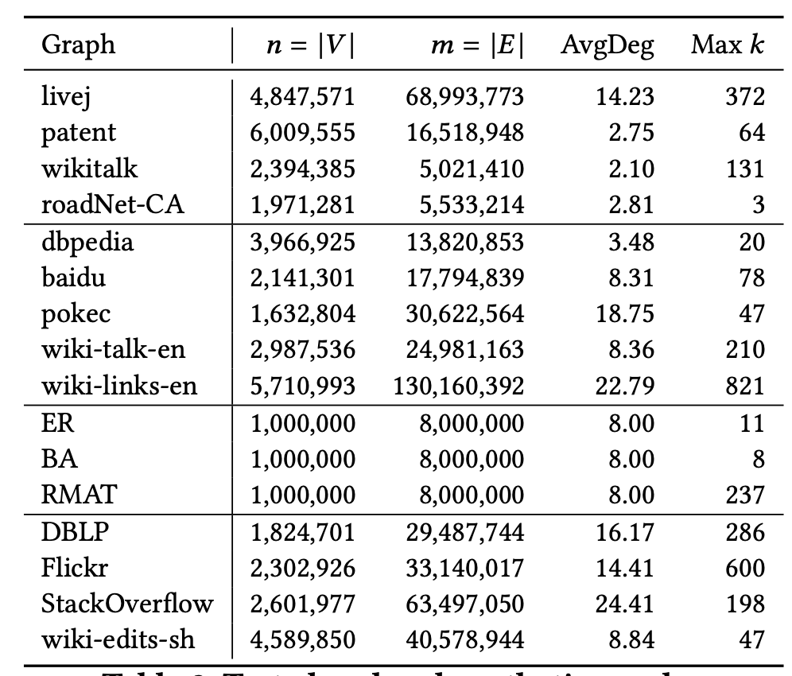
Tested Graphs
Social Networks
Road Network
Social Networks
Static Graphs
Hyperlink Network
Synthetic Network
Temporal Graphs
Dynamic Graphs
For static graphs, randomly select 100,000 edges for insertion and removal
For dynamic graphs, insert or remove 100,000 edges by their time stamps
Evaluate the the accumulated running times
Notes:
Erd¨os-R´enyi graph model (which generates a random graph),
the Barabasi-Albert graph model (which generates a graph with power-law degree distribution),
and the R-MAT graph model (which generates large-scale realistic graph similar to social networks), respectively

Slide 16
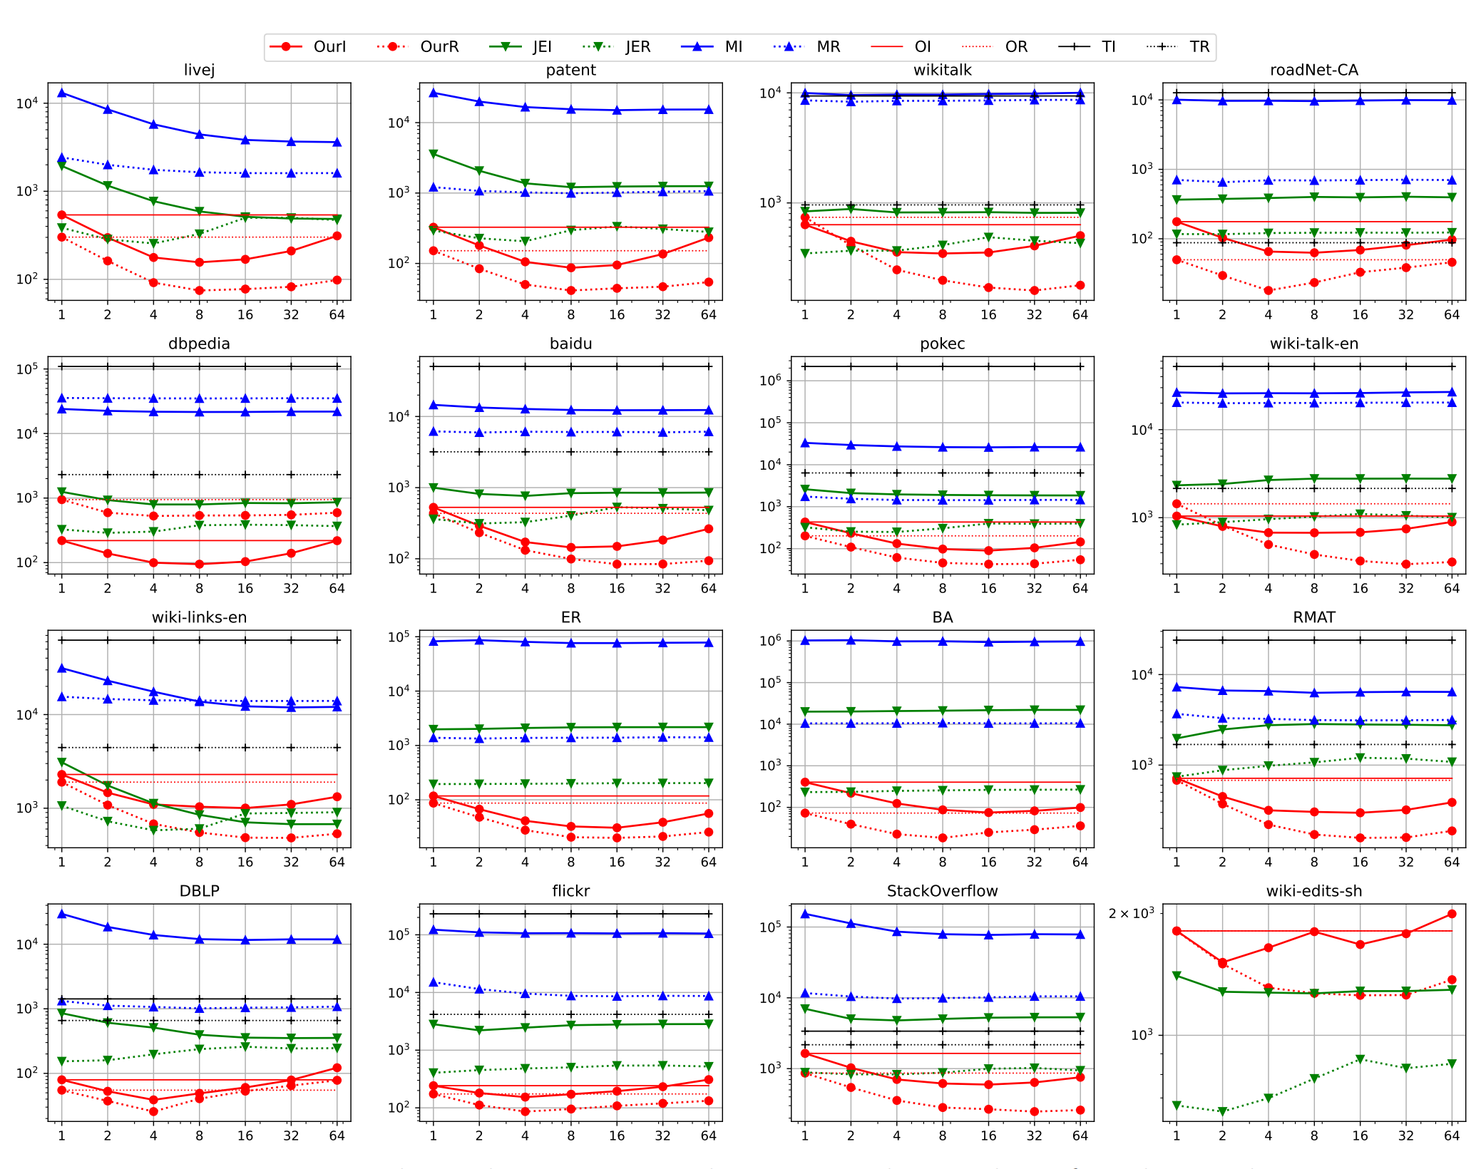
OurI | Our Insert
OurR | Our Remove
JEI | Join Edge Insert
JER | Join Edge Remove
MI | Match Edge Insert
MR | Match Edge Remove
OI | Sequential Order Insert
OR | Sequential Order Remove
TI | Sequential Traversal Insert
TR | Sequential Traversal Remove
Running time (ms)
With 1-worker, OurI and OurR is faster than JEI and JER
With 16-worker, OurI and OurR always has higher speedups than JEI and JER
Number of workers

Slide 17
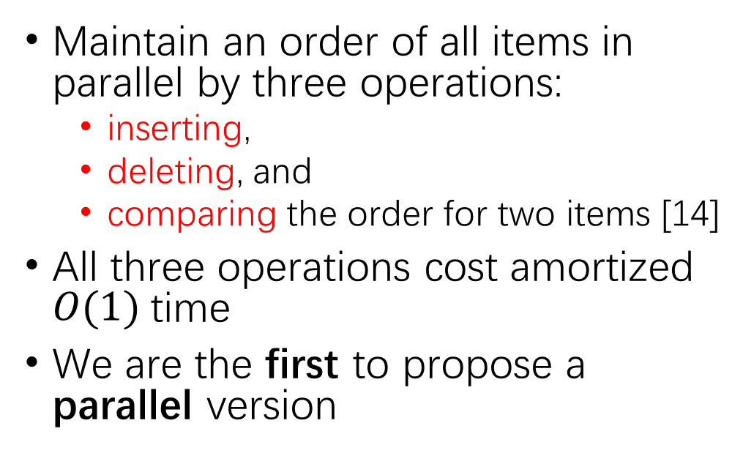
My Third Work: Parallel Order Maintenance
Maintain an order of all items in parallel by three operations:
  inserting,
  deleting, and
  comparing the order for two items [14]
All three operations cost amortized $O(1)$time
We are the first to propose a parallel version
8
10
20
a
b
c
v
?
u
9
[14] Bin Guo and Emil Sekerinski. "New Parallel Order Maintenance Data Structure." arXiv preprint arXiv:2208.07800 (2022).

Slide 18
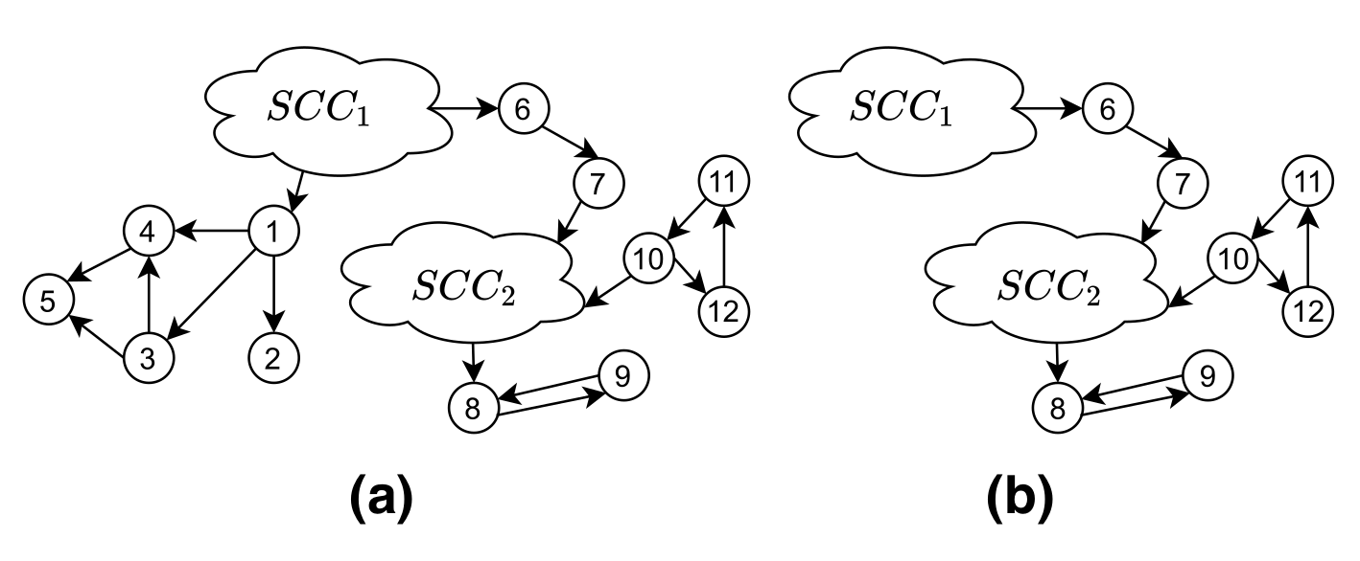
My Forth Work: Parallel Graph Trimming
Repeatedly remove all vertices without out-going edges [11]
  We compare three algorithms: AC3Trim, AC4Trim and AC6Trim.
Can be used on parallel SCC decomposition to remove size-1 SCC.
[11] “Efficient parallel graph trimming by arc-consistency” Bin Guo, Emil Sekerinski - The Journal of Supercomputing, 2022

Slide 19
Reference
[1] Kong, Yi-Xiu, et al. "k-core: Theories and applications." Physics Reports 832 (2019): 1-32.
[2] Burleson-Lesser, Kate, et al. "K-core robustness in ecological and financial networks." Scientific reports 10.1 (2020): 1-14.
[3] Lotito, Quintino Francesco, and Alberto Montresor. "Efficient Algorithms to Mine Maximal Span-Trusses From Temporal Graphs." arXiv preprint arXiv:2009.01928 (2020).
[4] Yikai Zhang, Jeffrey Xu Yu, Ying Zhang, and Lu Qin. A fast order-based approach for core maintenance. In Proceedings - International Conference on Data Engineering, pages 337–348, 2017.
[5] Ahmet Erdem Saríyüce, Buğra Gedik, Gabriela Jacques-Silva, Kun-Lung Wu, and Ümit V Çatalyürek. Streaming algorithms for 𝑘 -core decomposition. Proceedings of the VLDB Endowment, 6(6):433–444, 2013.
[6] Ahmet Erdem Sarıyüce, Buğra Gedik, Gabriela Jacques-Silva, Kun-Lung Wu, and Ümit V Çatalyürek. Incremental 𝑘 -core decomposition: algorithms and evaluation. The VLDB Journal, 25(3):425–447, 2016

Slide 20
[7] Na Wang, Dongxiao Yu, Hai Jin, Chen Qian, Xia Xie, and Qiang-Sheng Hua. Parallel algorithm for core maintenance in dynamic graphs. In 2017 IEEE 37th International Conference on Distributed Computing Systems (ICDCS), pages 2366–2371. IEEE, 2017.
[8] Hai Jin, Na Wang, Dongxiao Yu, Qiang Sheng Hua, Xuanhua Shi, and Xia Xie. Core Maintenance in Dynamic Graphs: A Parallel Approach Based on Matching. IEEE Transactions on Parallel and Distributed Systems, 29(11):2416–2428, nov 2018.
[9] Qiang-Sheng Hua, Yuliang Shi, Dongxiao Yu, Hai Jin, Jiguo Yu, Zhipen Cai, Xiuzhen Cheng, and Hanhua Chen. Faster parallel core maintenance algorithms in dynamic graphs. IEEE Transactions on Parallel and Distributed Systems, 31(6):1287–1300, 2019.
[10] Parallel Order-Based Core Maintenance in Dynamic Graphs B Guo, E Sekerinski - arXiv preprint arXiv:2210.14290, 2022 All 2 versions
[11] Efficient parallel graph trimming by arc-consistency B Guo, E Sekerinski - The Journal of Supercomputing, 2022
[12] δ-Transitive closures and triangle consistency checking: a new way to evaluate graph pattern queries in large graph databases Y Chen, B Guo, X Huang - The Journal of Supercomputing, 2020
[13] Guo, Bin, and Emil Sekerinski. "Simplified Algorithms for Order-Based Core Maintenance." arXiv preprint arXiv:2201.07103 (2022).
[14] Guo, Bin, and Emil Sekerinski. "New Parallel Order Maintenance Data Structure." arXiv preprint arXiv:2208.07800 (2022).

Slide 21
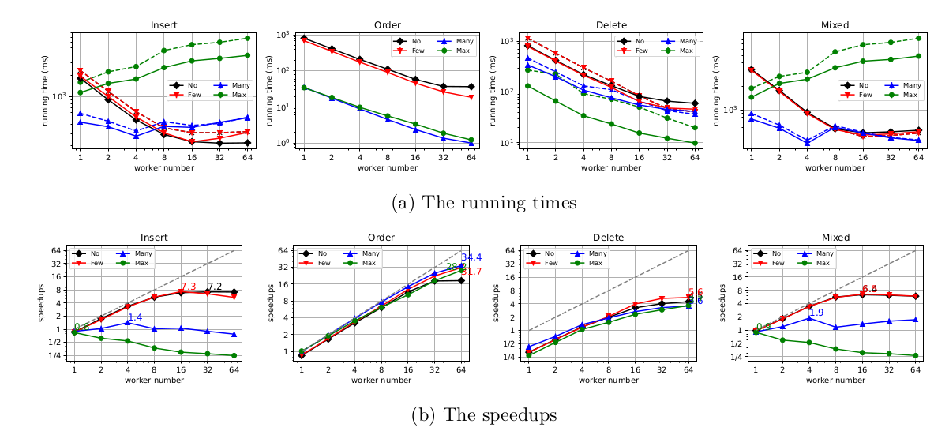
Insert 10 million items the Order list
Compare the Order of 10 million pair of items
Delete 10 million Items
Insert 10 million items, mixed with 100 million Order operations
No Case | 10 million random position, no relabel
Few Case | 1 million random position, few relabel
Many Case | 1000 random position, many relablel
Max Case | 1 random posion, maximum relabale

Slide 22
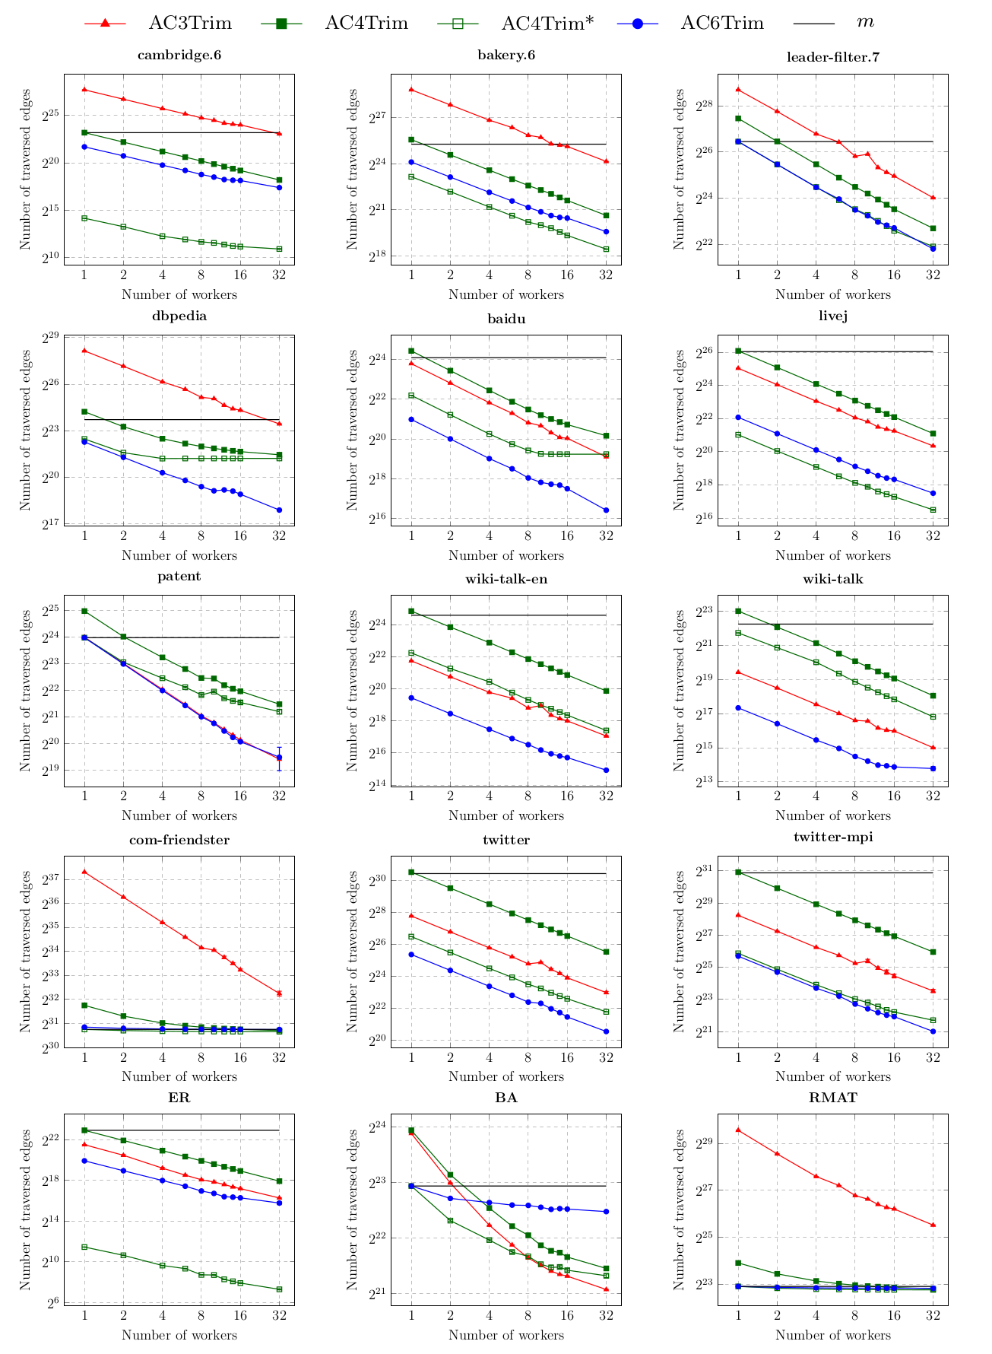
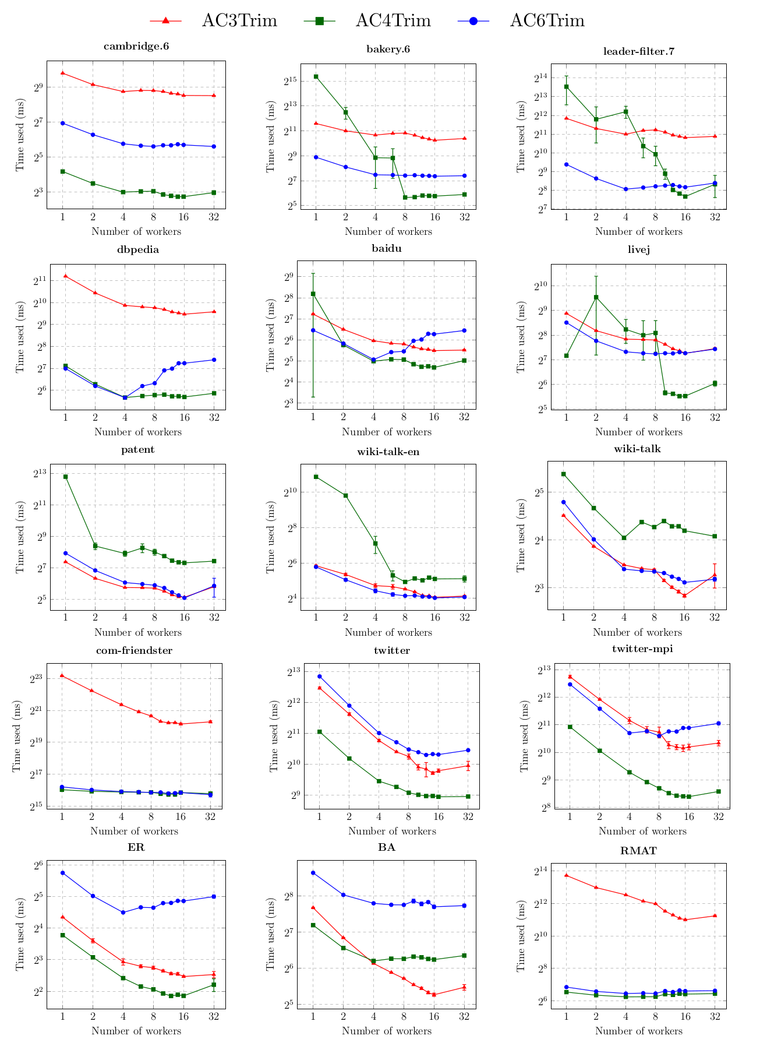
Evaluate the number of traversed edges
Evaluate the real running time

